Slide 1
Year 11 Parents Information Evening
Tuesday 17th November
Serving others, Growing together and Living life to the full

Slide 2
Serving others, Growing together and Living life to the full

Slide 3
So far……...............first day & week back
Students took part in a carousel of activities that included:
Emergency First Aid
Careers
Well-being
Wanted them to start to think about the next step, treat them like young adults and do things differently to the normal school day.
Serving others, Growing together and Living life to the full

Slide 4
Study skills
A form time each week is dedicated to study skills - a specific revision skill/method (mind mapping this week).
Not all students revise in the same way and many do not know where to start.
Practical/work examples to allow the students to work out what works best for them.
Each student will build up a bank of resources that they can use/choose from to help with their revision.
Where possible we encourage you to help/be part of their revision where possible – they like it!!
Serving others, Growing together and Living life to the full

Slide 5
Tutor groups/Contact information
House | Tutor Group | Tutor | Email address
ABBEY | 11JF | Dr J Fleming | d.fleming@manorceacademy.org
 | 11GCH | Ms G Hetmanski | g.hetmanski@manorceacademy.org
KINGS | 11LAH (was SJS) | Mrs L Hill | l.hill@manorceacademy.org
 | 11TF (was BR) | Mrs T Feetenby | t.feetenby@manorceacademy.org
STUART | 11RT | Ms R Trever | r.trever@manorceacademy.org
 | 11VB | Ms V Burge | v.burge@manorceacademy.org
WENTWORTH | 11PT | Mr P Tasker | p.tasker@manorceacademy.org
 | 11HL | Mrs H Landon | h.landon@manorceacademy.org
Serving others, Growing together and Living life to the full

Slide 6
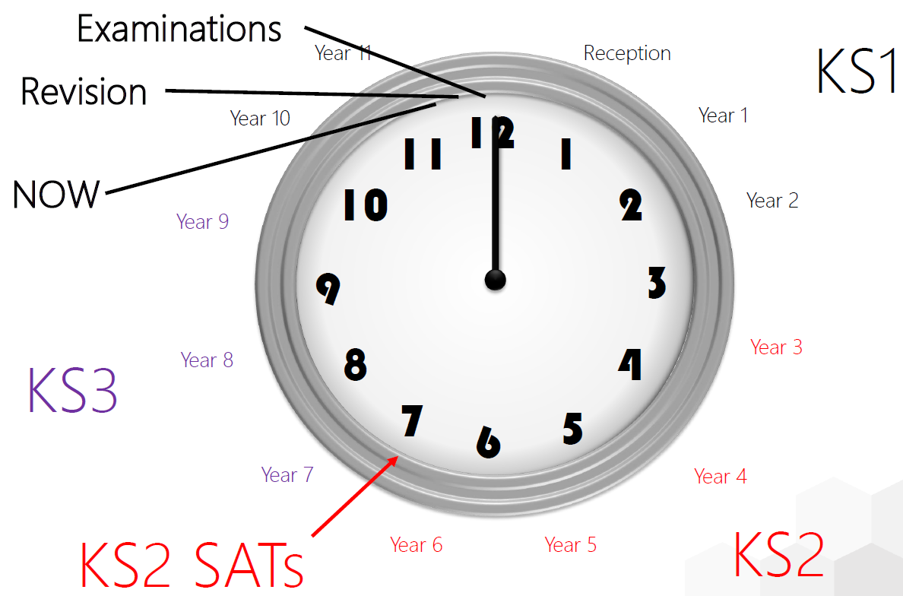
Into the last year of fully structured schooling…
Serving others, Growing together and Living life to the full

Slide 7
Exam Timeline for Year 11
Mock Exam Period 1
Parents Evening
Mock Exam Period 2
GCSE Exams
5th – 15th Nov 2019
11th Dec 2019
3rd – 11th Feb 2020
11th May – 18th June
Exams in all subjects
Personalized updates from staff
Exams in Core & Ebacc Subjects
ALL GCSES. Personalized timetables provided 12th June = Final Sci
Serving others, Growing together and Living life to the full

Slide 8
Key Dates – 2019/20
17th September - Y11 Parents Information Evening
23rd October - Career Morning – Periods 1 & 2
5th – 15th November - Mock Exam Period 1
2nd December - Report 1 Issued
11th December - Y11 Parents Evening
3rd – 11th February - Mock Exam Period 2
2nd March - Report 2 Issued
11th May – 18th June - GCSE Exam Period
24th June - Year 11 Prom
http://www.manorceacademy.org/wp-content/uploads/2019/06/Manor-CE-Academy-term-dates-and-training-days-2019-20-1.pdf
Serving others, Growing together and Living life to the full

Slide 9
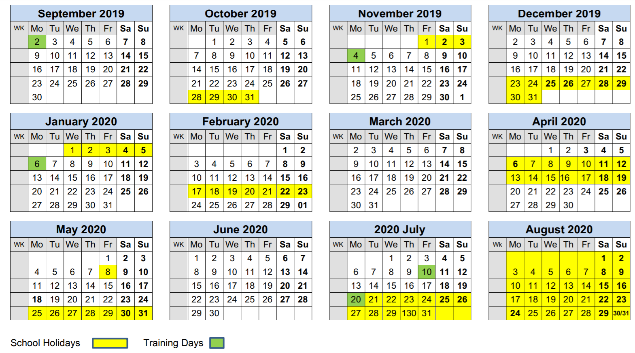
Key Dates – 2019/20
http://www.manorceacademy.org/wp-content/uploads/2019/06/Manor-CE-Academy-term-dates-and-training-days-2019-20-1.pdf
Serving others, Growing together and Living life to the full

Slide 10
Advice To be given to students…
Maximise attendance
• If in doubt over illness – come to school
• Be punctual
• Late arrival misses key lesson starters
Make use of revision sessions, resources and staff expertise
• Revise at home – in school work will not be enough
• Make use of practice resources
• Make a reasonable programme and stick to it
• Be ACTIVE in revision
• Revising is not ‘time off’ but a crucial part of your exam preparation
• Take responsibility for own success
Serving others, Growing together and Living life to the full

Slide 11
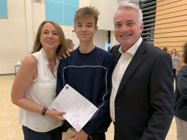
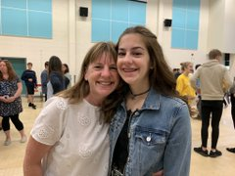
Parents –What can you do?
Number 1 rule: Be overwhelmingly positive
• 2 for 1 rule (2 periods of work for 1 period of time off)
• Help your child to get in the right frame of mind
• Be ready for stress – stay calm and help them deal with it
• Don’t join the anxiety (even if you feel it!)
• Help your child plan revision – get them started early
• Agree a reasonable programme and help them stick to it
• Provide a quiet calm environment to revise
• Provide plenty of food and drink, treats and rewards
• Provide resources–revision guides / stationery / exam pack. School will provide guidance here
If you need support or advice –contact us!!!
Serving others, Growing together and Living life to the full

Slide 12
Example of a Revision Timetable
15 hours per week
15 weeks
225 hours
Serving others, Growing together and Living life to the full

Slide 13
Tonight’s sessions
6:20-6:40 Rotation 1
6:40-7:00 Rotation 2
7:00-7:20 Rotation 3
7:20-7:40 Rotation 4
Group | Colour | 1 | 2 | 3 | 4
1 | Red | English (P2) | Maths (Hall) | Wellbeing or Careers (S9 or S10) | Y11 Tutors & Refreshments (Balcony)
2 | Green | Y11 Tutors & Refreshments (Balcony) | English (P2) | Maths (Hall) | Wellbeing or Careers (S9 or S10)
3 | Yellow | Wellbeing or Careers (S9 or S10) | Y11 Tutors & Refreshments (Balcony) | English (P2) | Maths (Hall)
4 | Blue | Maths (Hall) | Wellbeing or Careers (S9 or S10) | Y11 Tutors & Refreshments (Balcony) | English (P2)
Serving others, Growing together and Living life to the full

