Slide 1
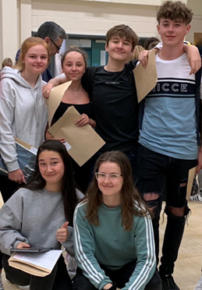
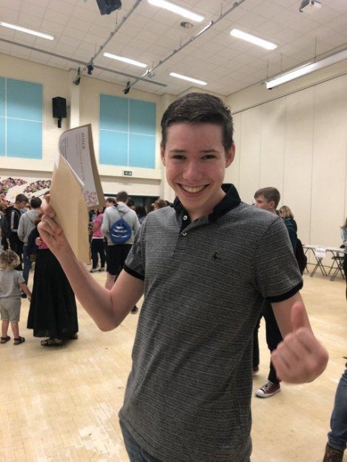
Information for Y11 parents 2019-20
Manor CE Academy
English Department
Notes:
Picture?

Slide 2
Staff in the English team
Mrs Lowman – Director of Learning, 2iC, AAP
Mr Metcalfe – 2iC
Y11 class teachers
[Mrs Bowes – Director of Learning on Mat leave]
Mrs Brown
Mr Hugill
Mrs Jones
Mrs Lowman
Mrs McGivern
Mr Metcalfe
Dr Rock
Ms Sullivan

Slide 3
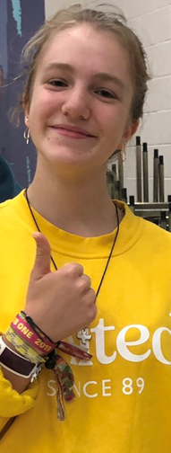
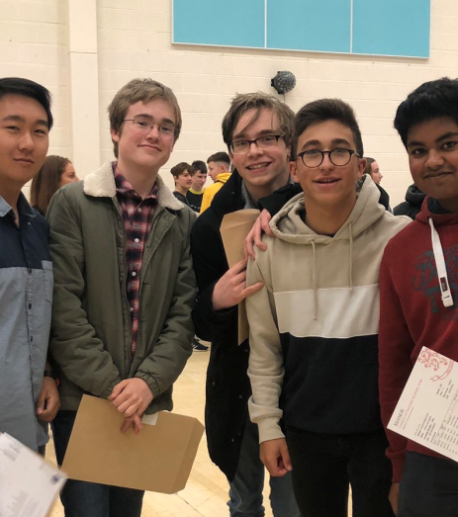
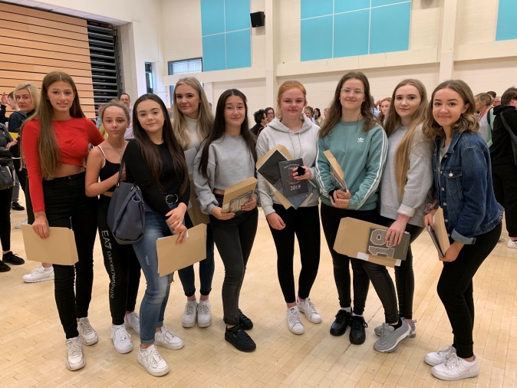
English results August 2019
English Results Overall
9-7: 39.3%
9-5: 78.1%
9-4: 89.6%
These are fantastic results!!!

Slide 4
GCSE English Language and Literature
100% Examination for both Language and Literature
Closed book exams – no texts taken into the exams at all
Speaking and Listening accreditation
Reported separately on students’ certificates but not included in the GCSE grade

Slide 5
The two English GCSE qualifications
English Language
100% exam
Two papers
Paper 1 50% 1hr 45 m FICTION
Sec A: READING
Sec B: WRITING
Paper 2 50% 1 hr 45 m NON FICTION
Sec A: READING
Sec B: WRITING
English Literature
100% exam
Two papers
Paper 1 40% 1hr 45 m
Sec A: Shakespeare
Sec B: 19th Century Novel
Paper 2 60% 2 hr 15 m
Sec A: Modern Drama
Sec B: Cluster poems
Sec C: Unseen poems
Notice the length of this exam!

Slide 6
English Language – in detail
English Language
Paper 1 50%, 1hr 45 m Reading and writing skills
One unseen modern fiction text
Four questions looking at:
i) Comprehension
ii) Language
iii) Structure
iv) Critical analysis
v) Students will then write a descriptive and/or narrative piece based on an unseen picture or task.
Paper 2 50%, 1 hr 45 m Reading and writing skills.
Two unseen texts:
One 19th century non-fiction text and a modern non-fiction text
Four questions looking at:
i) Comprehension
ii) Summary of two texts
iii) Language
iv) Comparison of Methods
v) Students will then write for a given audience and a given purpose.
Notes:
Green = completed by now

Slide 7
English Literature – in detail
English Literature
Paper 1 40%, 1hr 45m
Shakespeare (e.g. Macbeth)
A 19th century novel (A Christmas Carol or The Strange Case of Dr Jekyll and Mr Hyde)
One question per text
Closed book exam
Paper 2 60%, 2 hr 15m
A Modern Text (e.g. An Inspector Calls) – choice of two questions
Comparison of two poems from a cluster of poetry
Two unseen poems
Closed book exam
Notes:
Green = completed by now

Slide 8
Our Y11 plan
AUT 1 | AUT2 | SPR 1 | SPR 2 | SUM 1 | SUM 2
Poetry and Modern Drama | MOCK EXAM – Literature Paper 2 19th Century Novel | English Language Paper 1 MOCK EXAM – English Language Paper 1 | Macbeth and 19th Century Novel MOCK EXAM – Lit Paper 1 REVISION including Language Paper 2 | REVISION | EXAMS
English Literature Paper 1 Wednesday 13th May 2020 a.m.
English Literature Paper 2 Thursday 21st May 2020 a.m.
GCSE Dates
English Language Paper 1 Tuesday 2nd June 2020 a.m.
English Language Paper 2 Friday 5th June 2020 a.m.

Slide 9
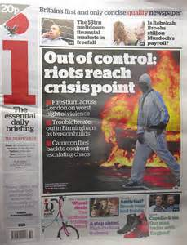
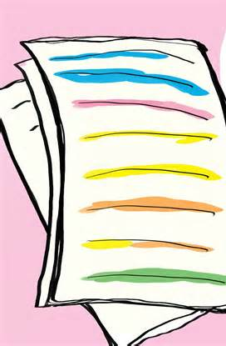
How can parents / guardians help?
Encourage regular reading of quality non-fiction – leaflets, Metro, The i newspaper, The Guardian, The Telegraph. (Online versions are usually free)
Discuss the issues, audience and purpose of each text – this is particularly helpful for English Language Paper 2
Help students to make a manageable plan for re-reading their exam texts (January onwards). Encourage discussion of the texts. See productions of the drama texts and possibly read the texts yourself so that you can have meaningful discussions!
Encourage quote learning by allowing posters and displays of key quotes around the house
Encourage a high standard of Spelling, Punctuation and Grammar (SPaG) in any writing done at home
Remind your young person about regular homework so that they don’t feel overwhelmed

Slide 10
How can students revise effectively?
Re-reading texts is very important (avoid only watching film adaptations as part of revision – it can be a very different plot in a film compared to the book).
When re-reading, students should keep a notepad handy to jot down any insights or ideas that occur to them and any further useful quotations.
To revise poetry, students are best off attempting practice questions, which can be found online or even generated by the students themselves. They should set time limits in line with the exam and use their notes at first before using clean copies of them poems.

Slide 11
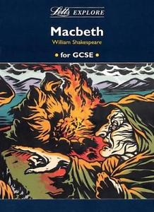
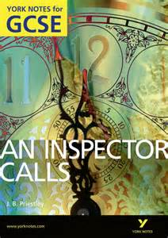
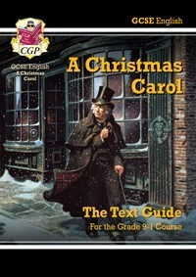
Recommended revision resources
CGP guides available through school
Letts GCSE revision guides
York Notes revision guides
BBC Bitesize online
SparkNotes online
Avoid Wikipedia/Yahoo answers
If your young person can get hold of their own copy of the literature texts, that is really helpful – they can annotate them and fill them with post it notes!

Slide 12
Any questions?

Slide 13
